Slide 1
Building Web Application With JavaEE
What is Web Application?
What is JavaEE?
JavaEE Containers
Simple JavaEE Architecture
JavaEE Directory Structure
Example

Slide 2
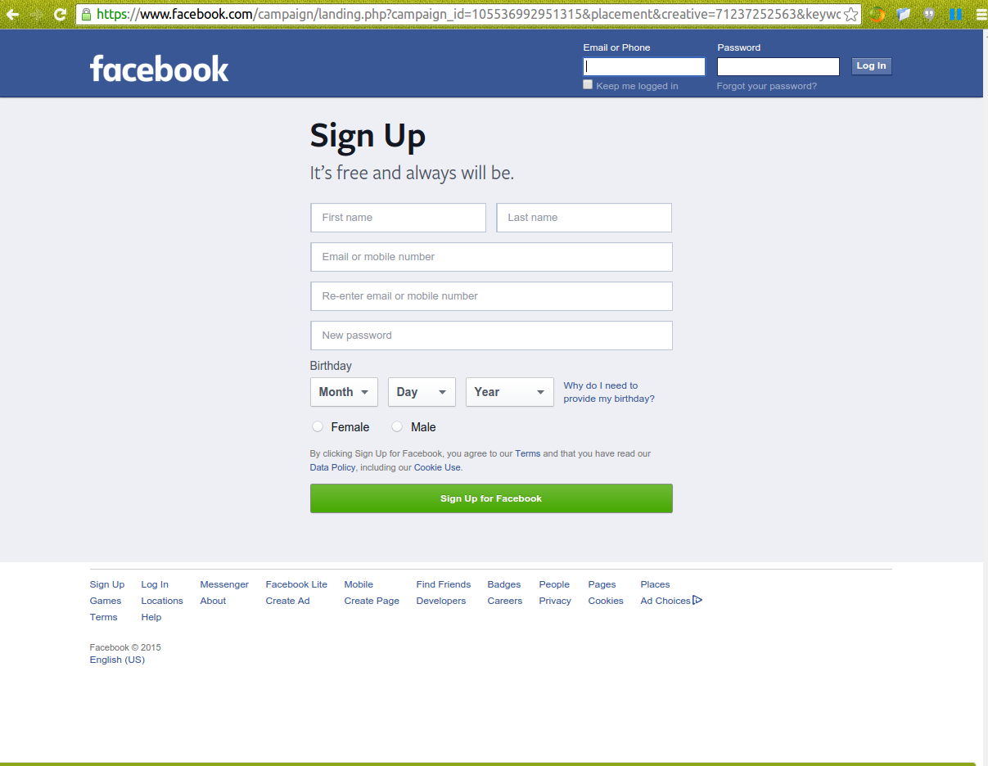
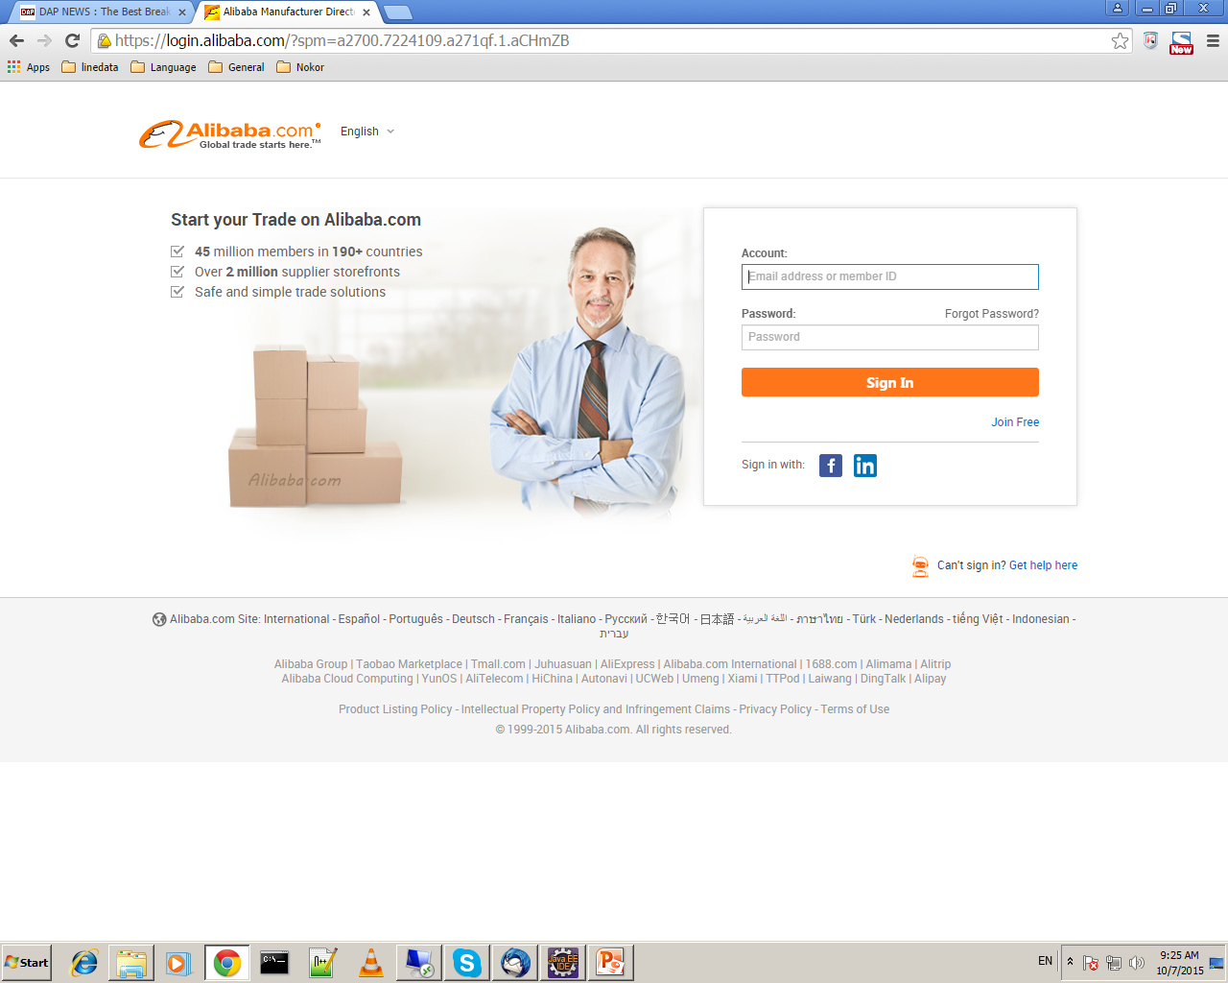
1. What is Web Application?
Web Application is a client-server application in which runs in a web browser.
Example:
www.facebook.com
www. alibaba.com

Slide 3
2. What is JavaEE?
JavaEE is a Java Enterprise Edition of the Java technology that helps us to build a large, secure, and scalable enterprise application.
JavaEE provides an API(JSP, Servlet, EJB,….) for developing enterprise web application.

Slide 4
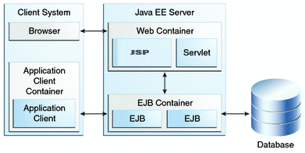
3. JavaEE Containers

Slide 5
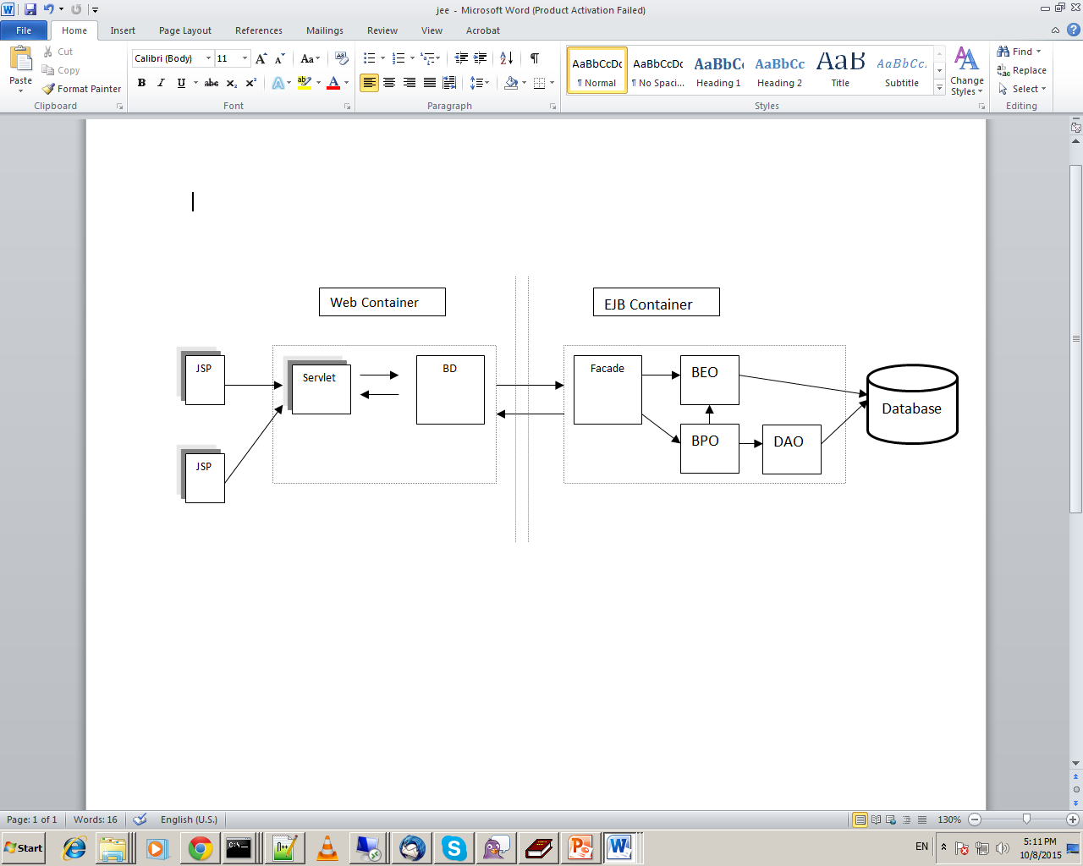
4. Simple JavaEE Architecture
BD : Business Delegate
BEO : Business Entity Object
BPO : Business Process Object
DAO : Data Access Object

Slide 6
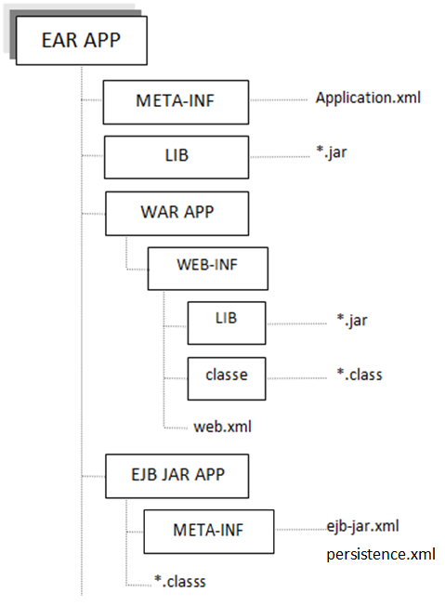
5. JavaEE Directory Structure

Slide 7
6. Example
Requirement
Environment Variable Configuration
JBOSS wildfly Configuration
Maven3 Command
Expected Output
Design Simple JavaEE Architecture
JavaEE Directory Structure
Coding

Slide 8
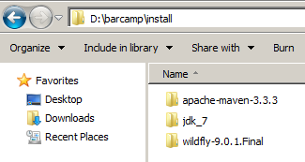
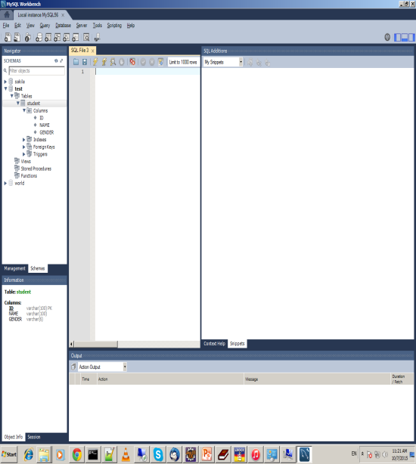
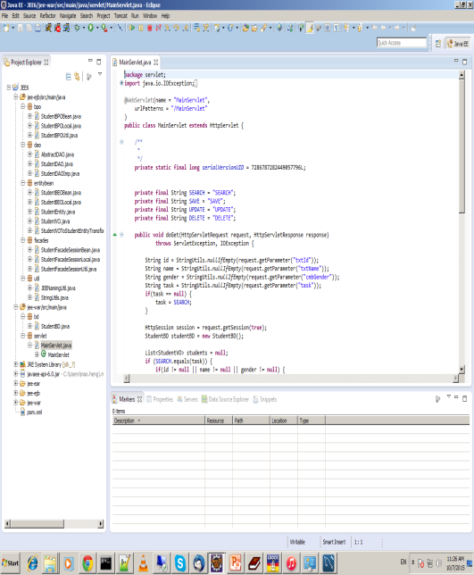
Requirement
Java : JDK 7
Tool : Eclipse
Build : Maven 3
Application Server : JBOSS wildfly-9.0.1.Final
Database : MySQL
MySQL
Eclipse

Slide 9
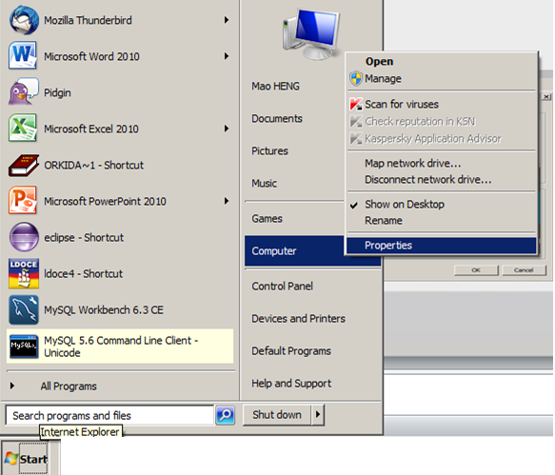
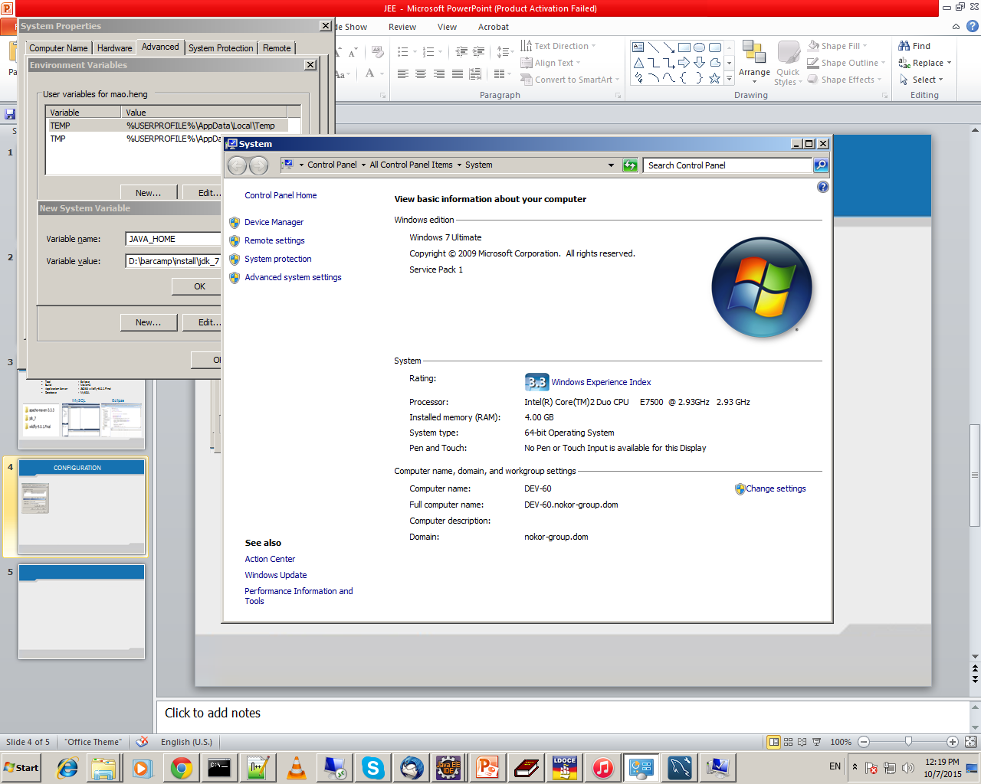
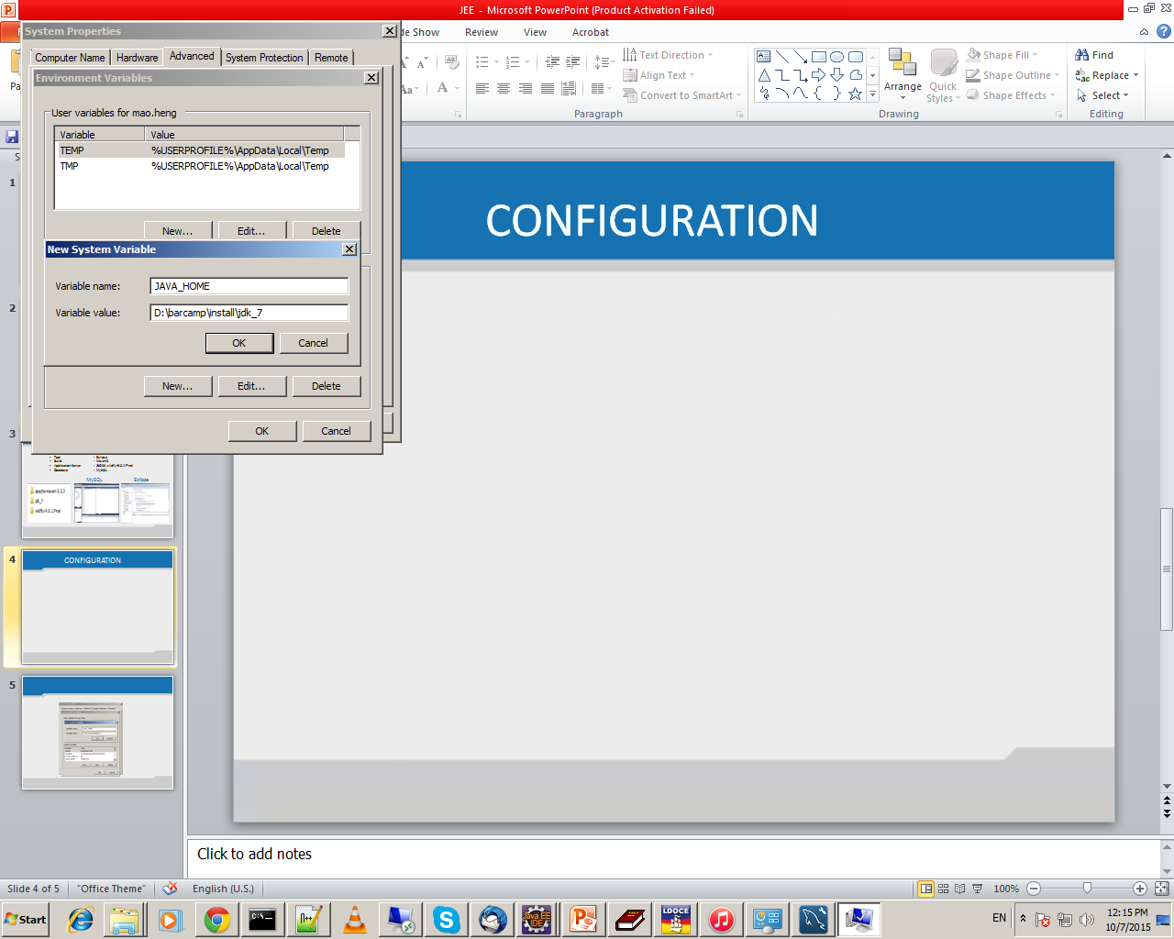
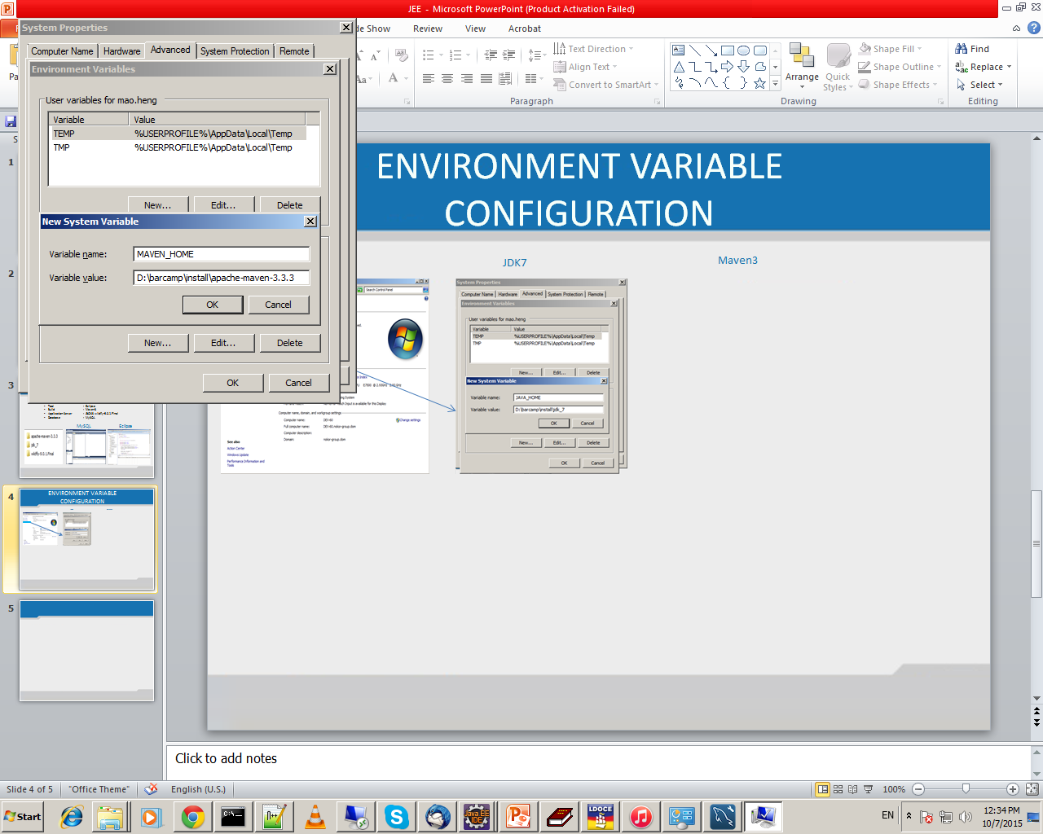
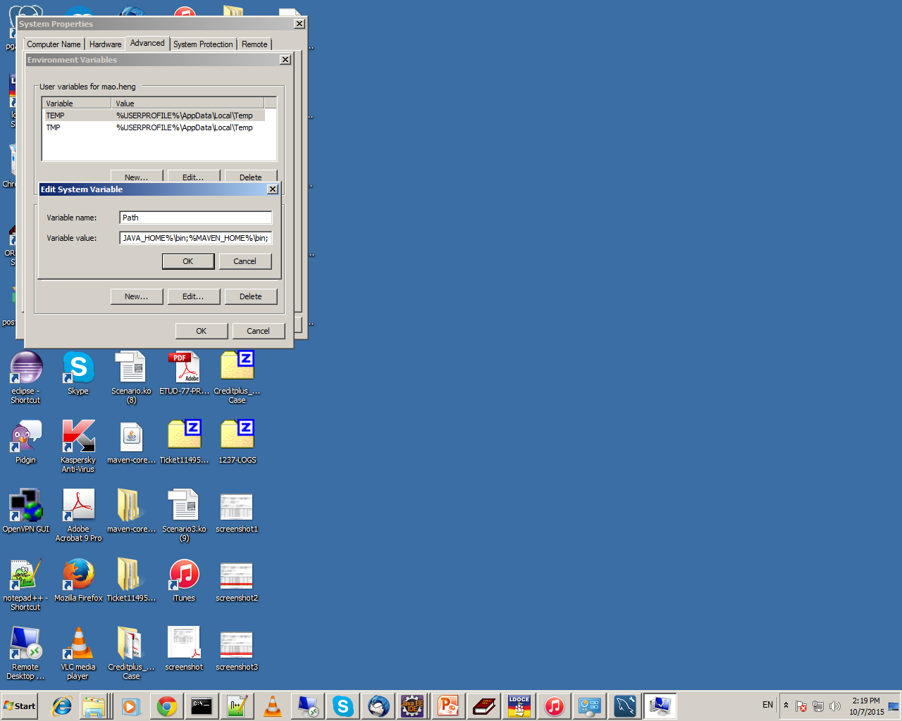
Environment Variable Configuration
JDK_7
Maven3

Slide 10
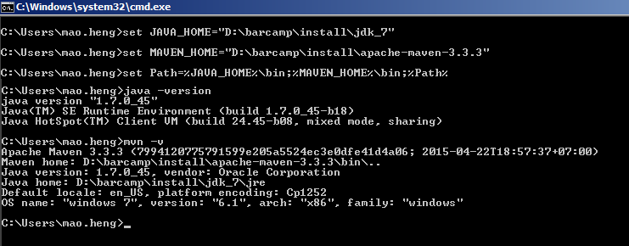
Environment Variable Configuration by MS-DOS prompt

Slide 11
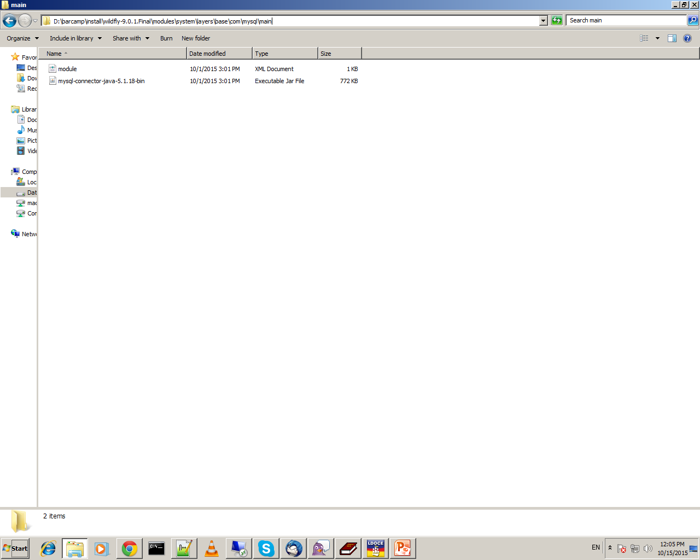
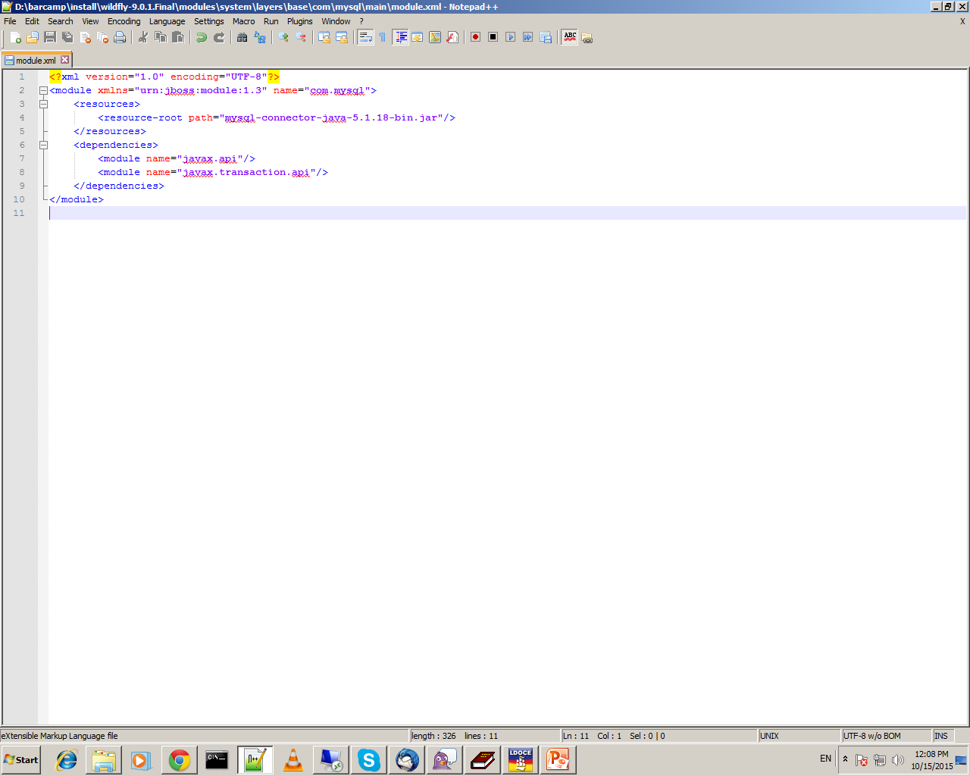
JBOSS wildfly Configuration
Database Connection

Slide 12
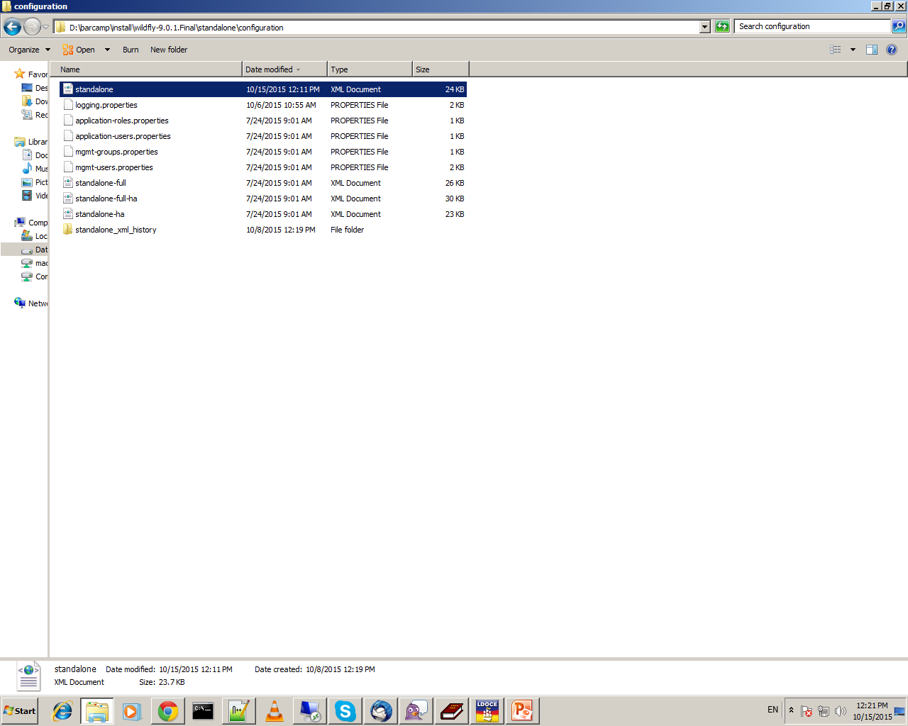
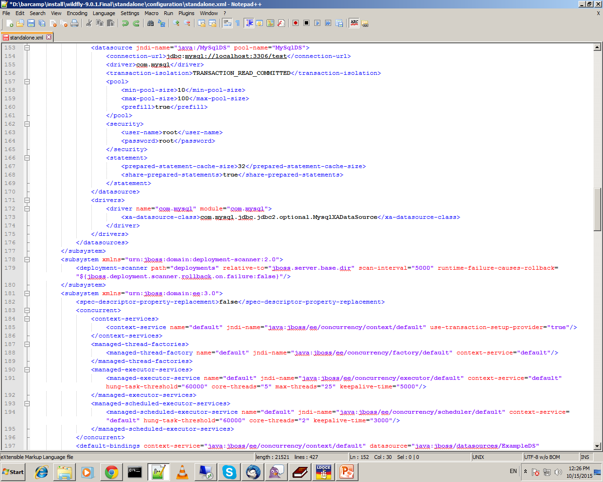

Slide 13
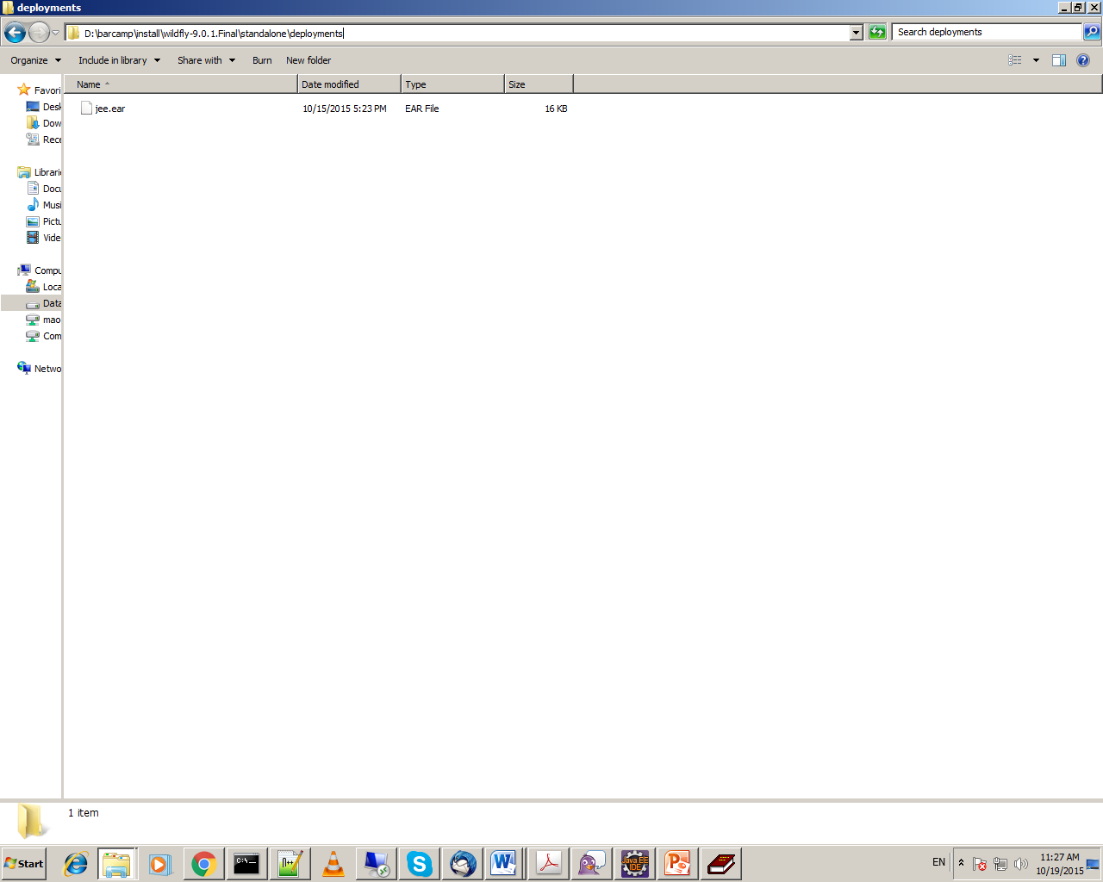
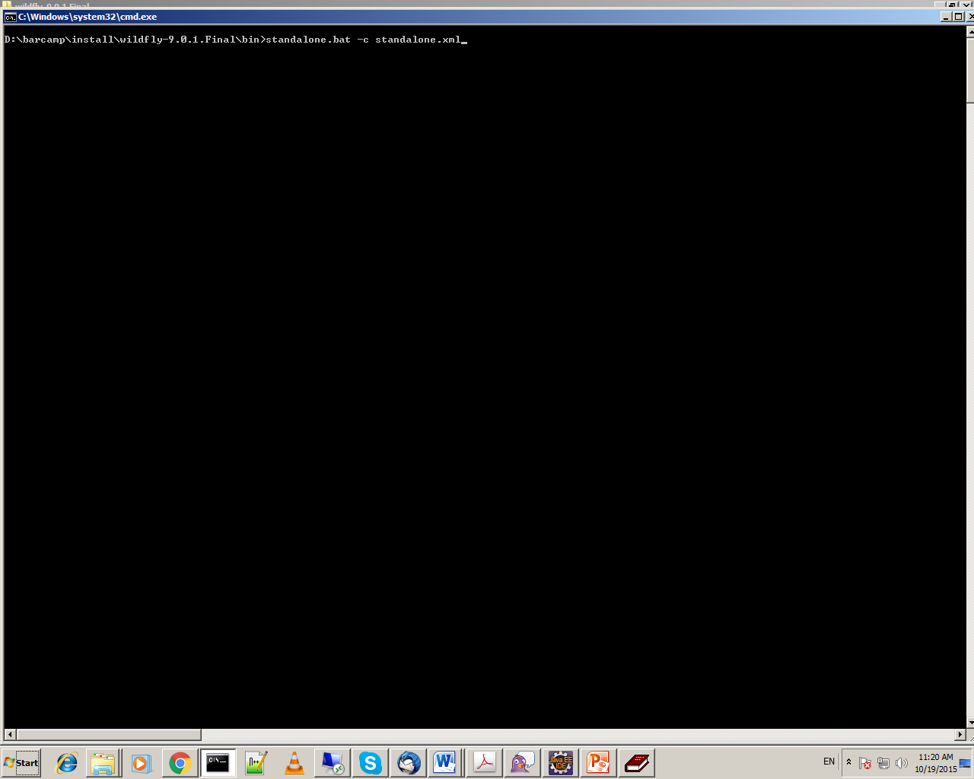
Deployment

Slide 14
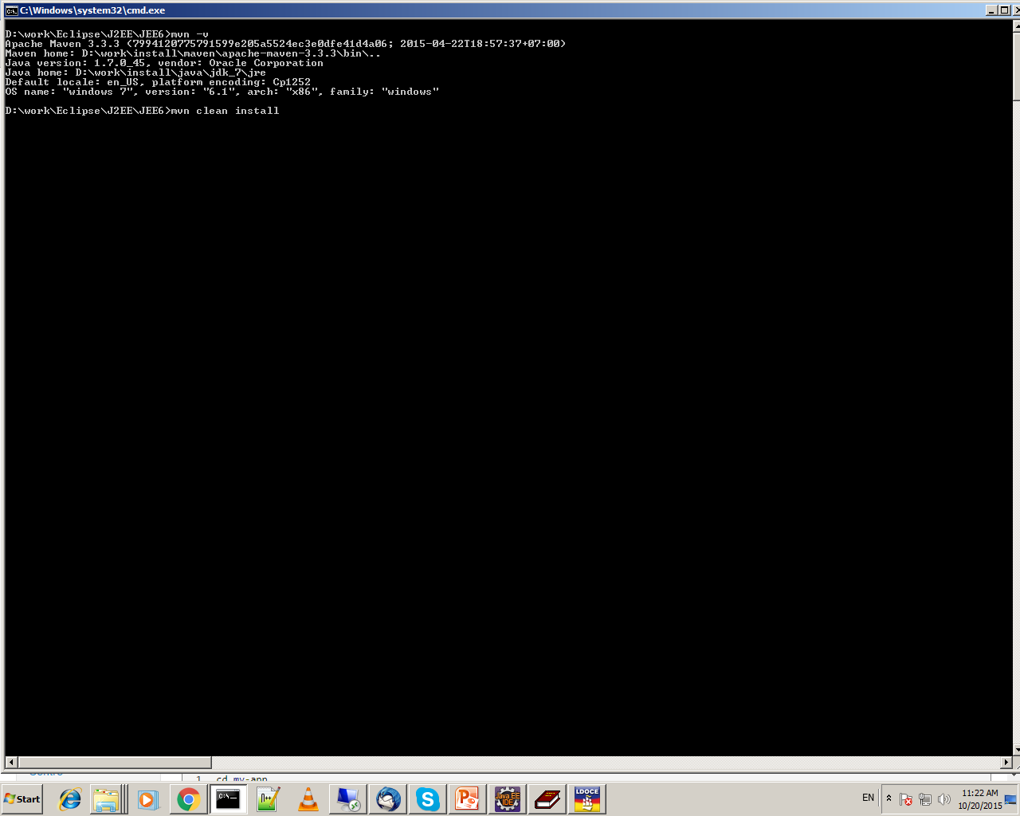
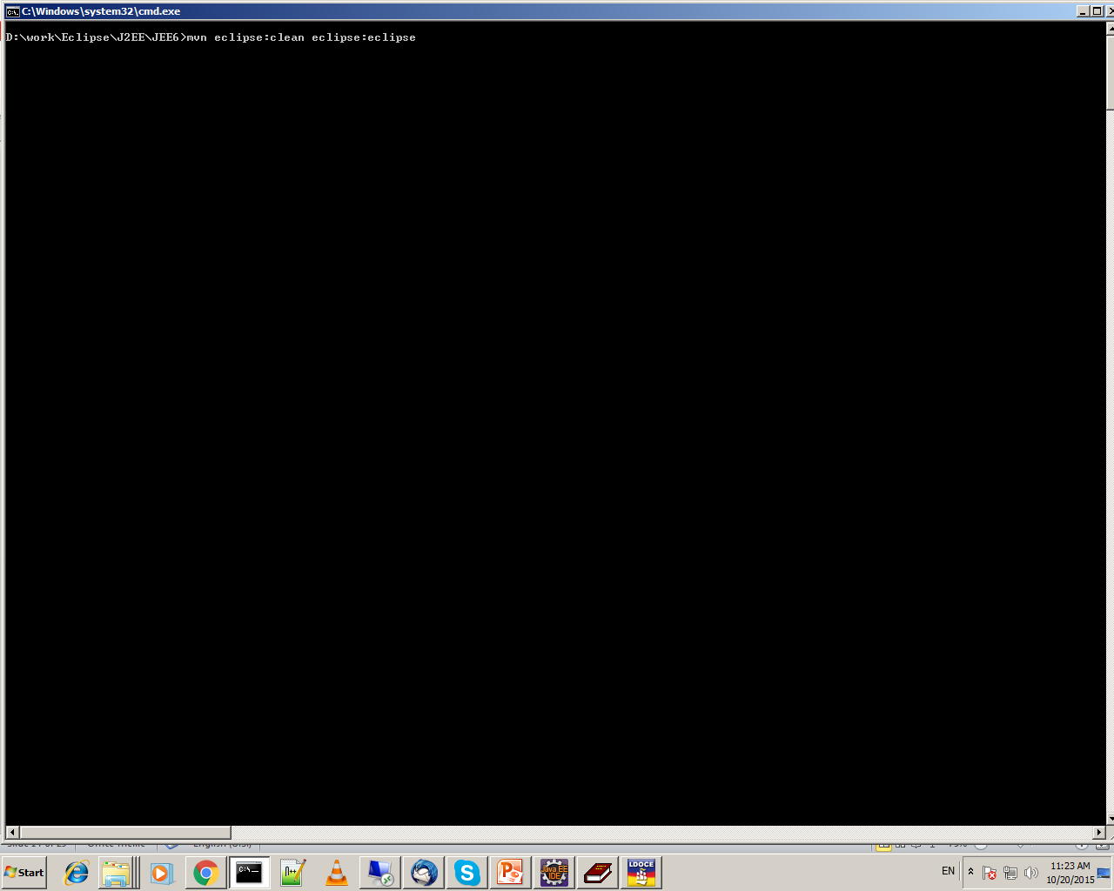
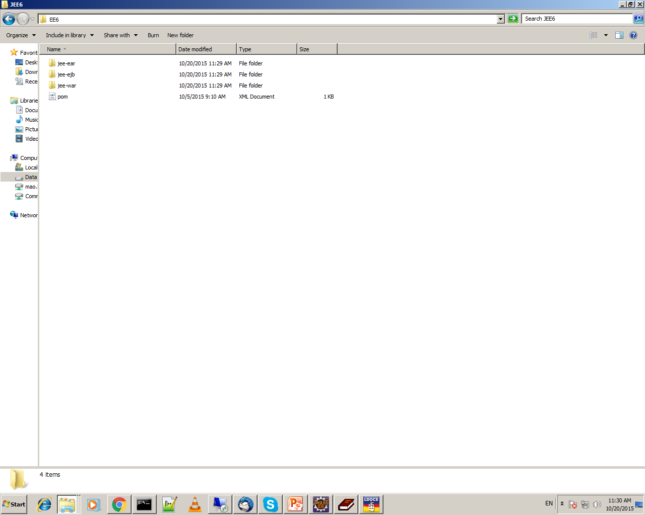
Maven3 Command

Slide 15
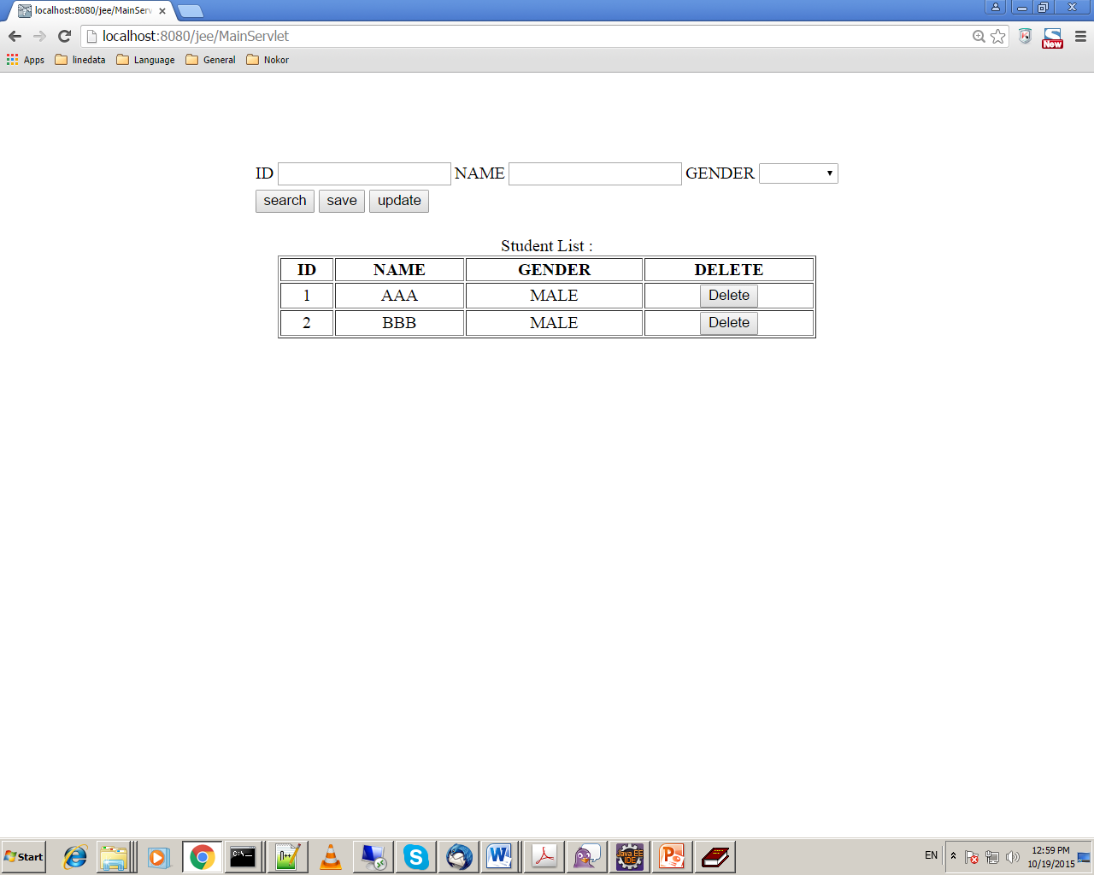
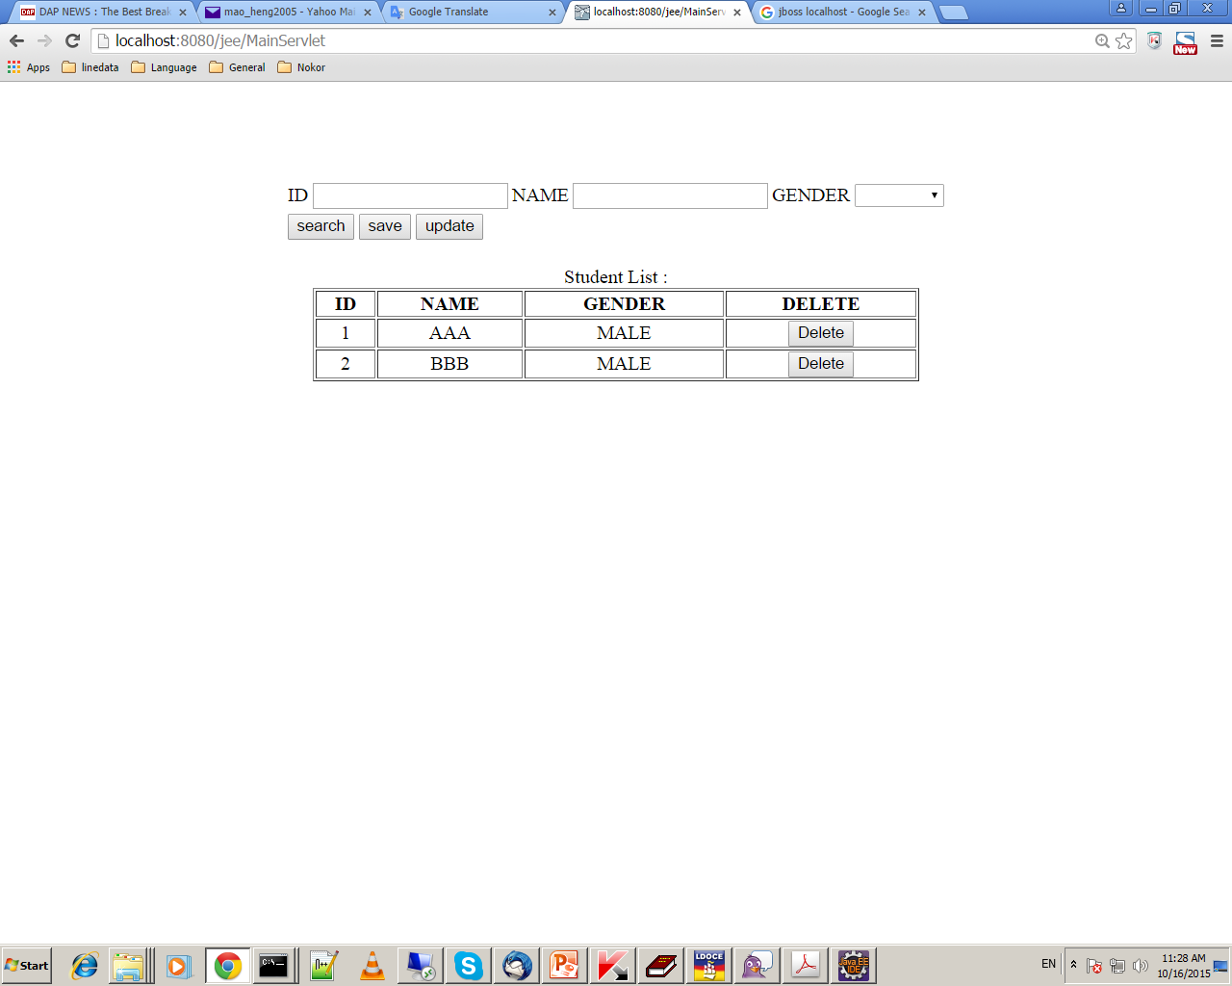
Expected OUTPUT

Slide 16
Design Simple JavaEE Architecture
JSP : student.jsp
Servlet : MainServlet.java
BD : StudentBD.java
Facade : StudentFacadeSessionBean.java
BEO : StudentBEOBean.java
BPO : StudentBPOBean.java
DAO : StudentDAO.java

Slide 17
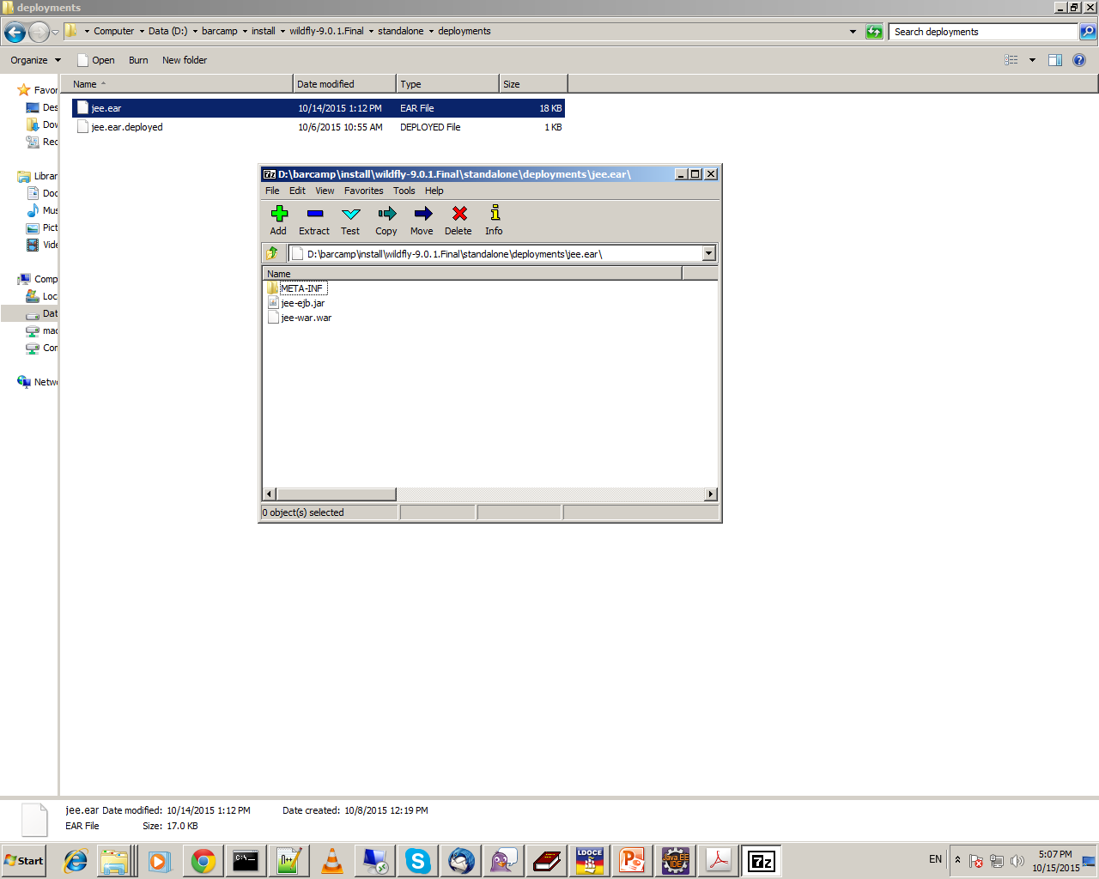
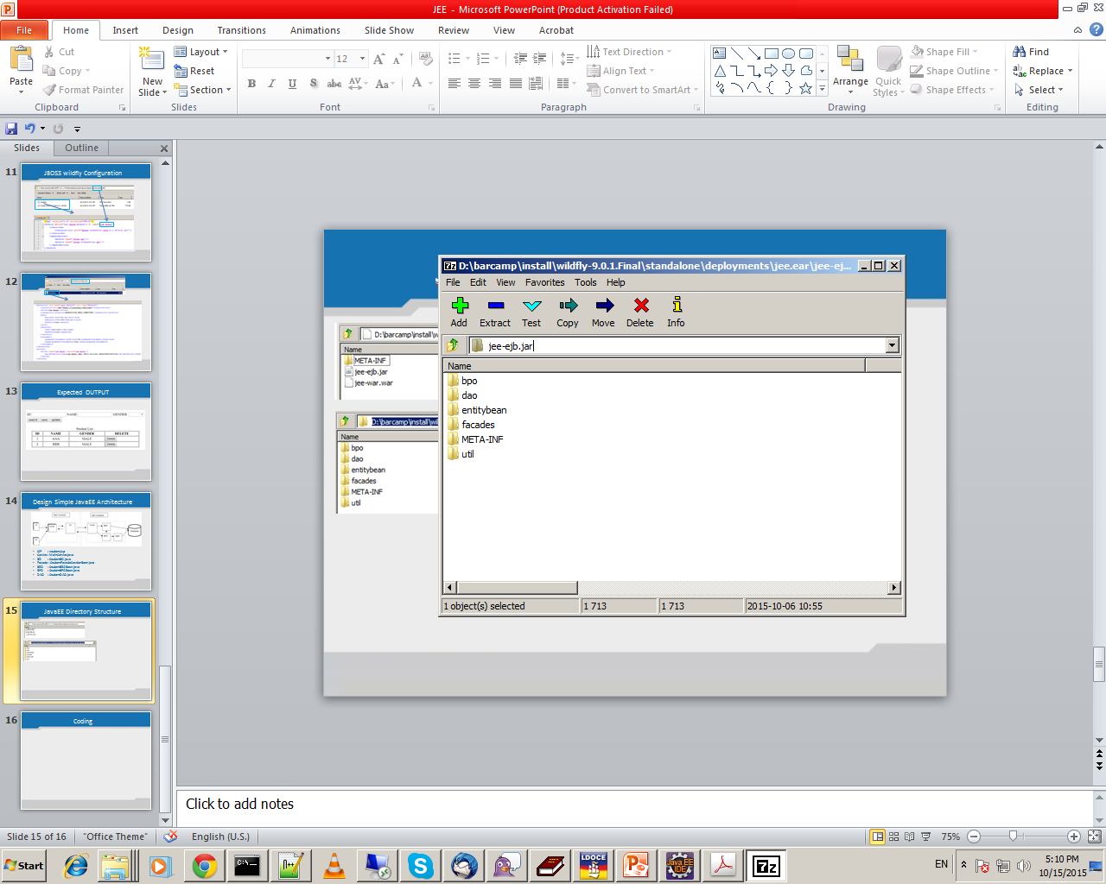
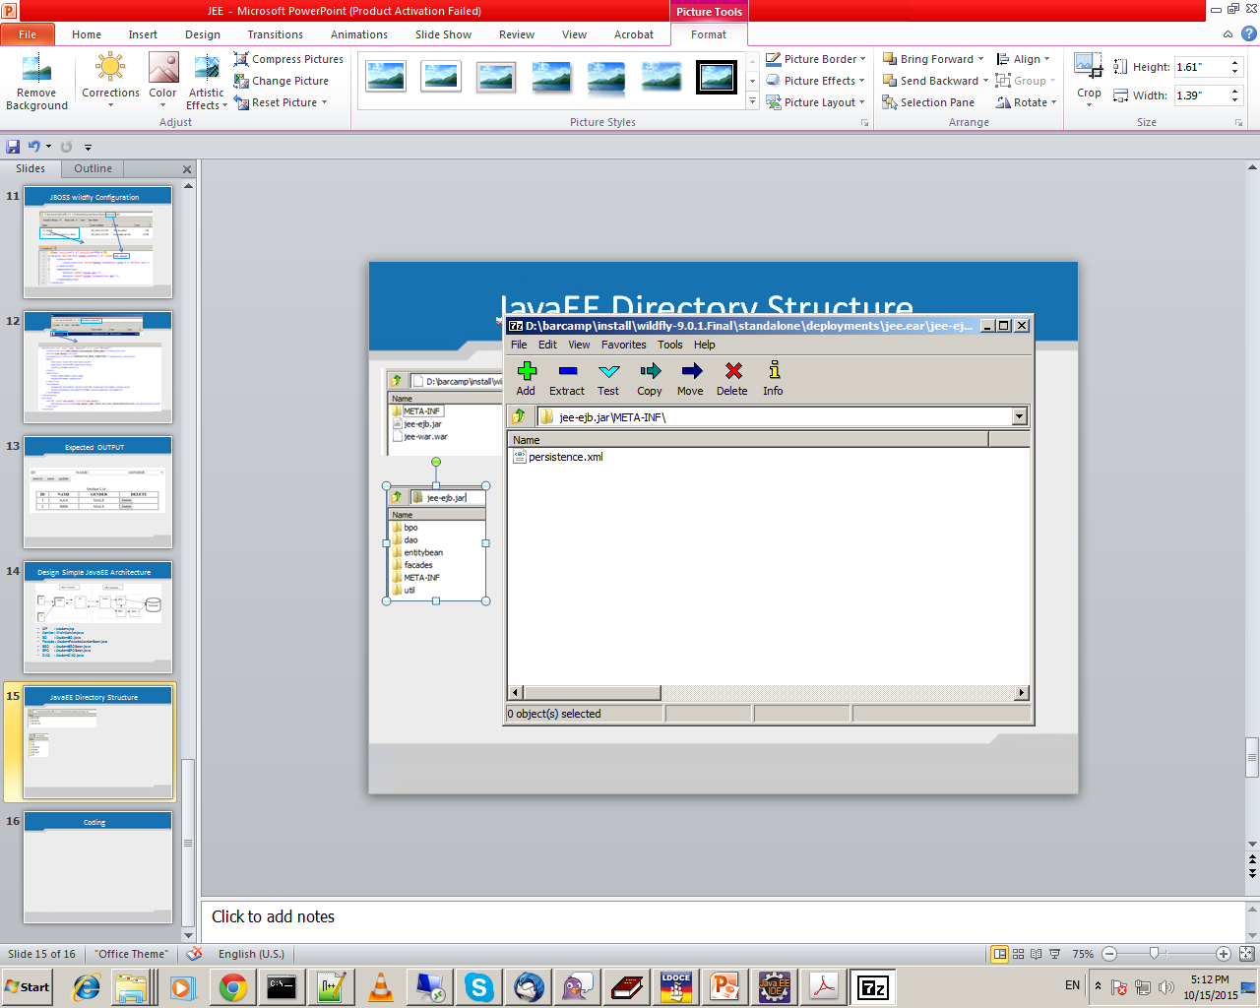
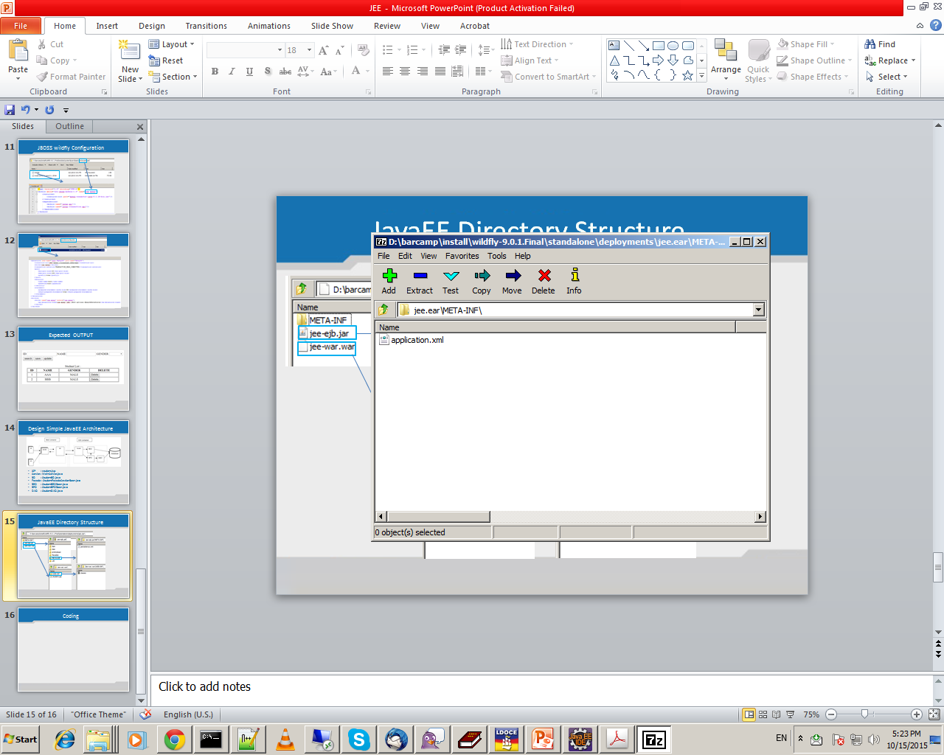
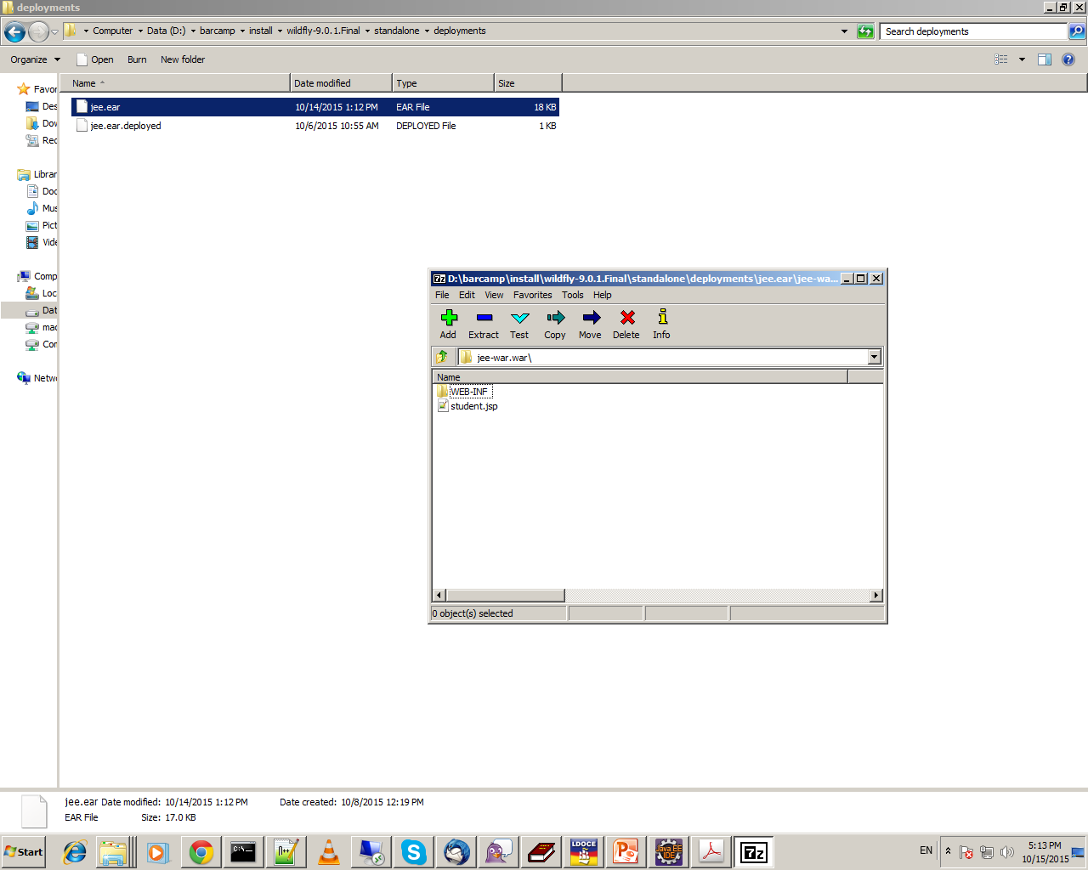
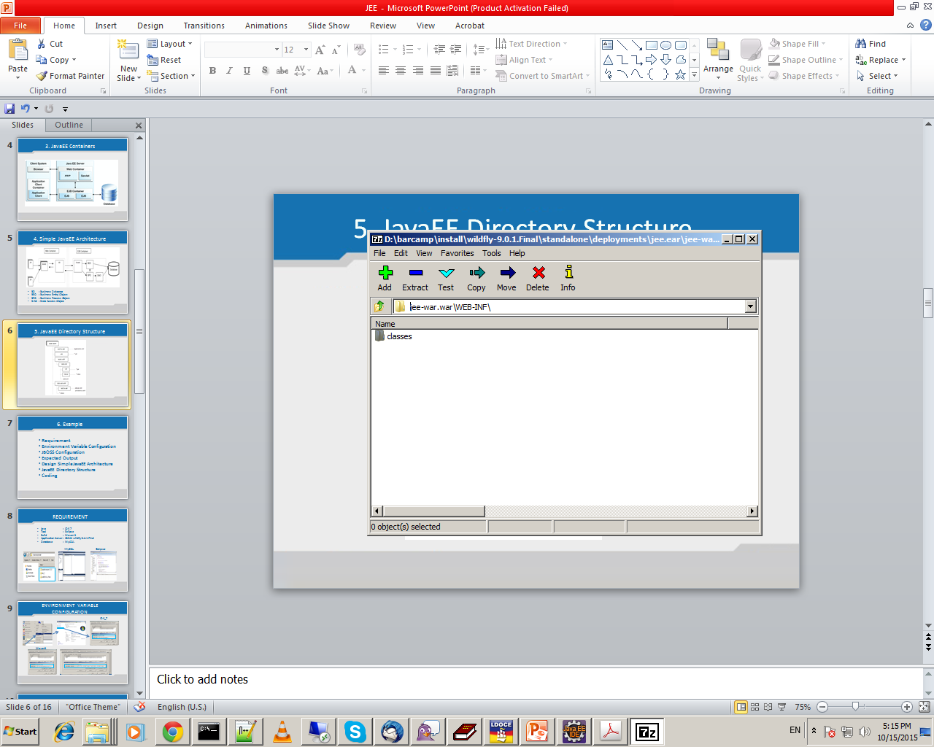
JavaEE Directory Structure

Slide 18
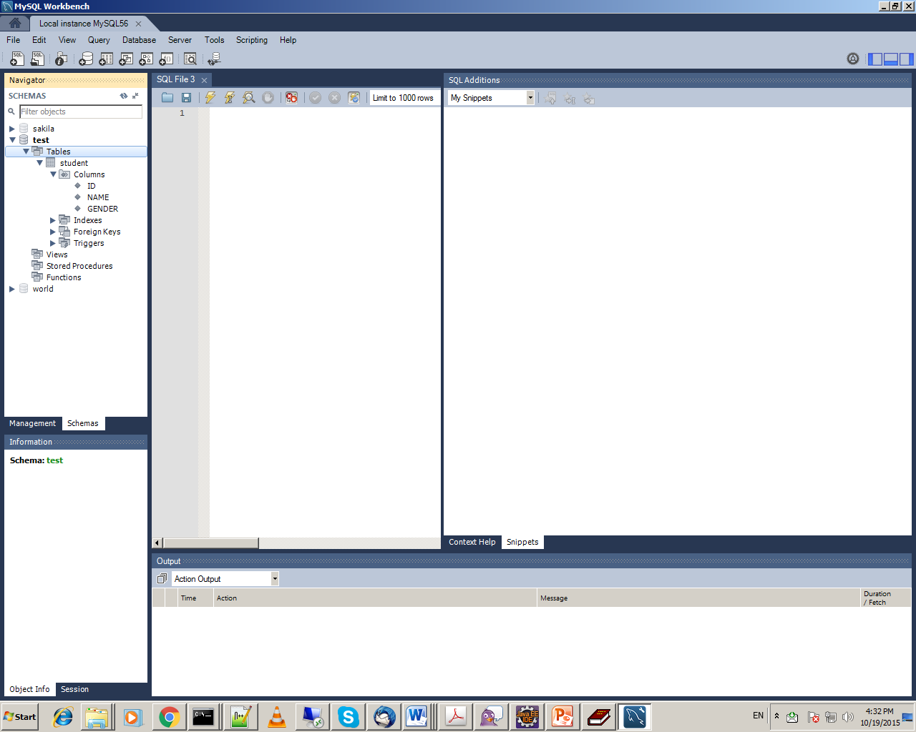
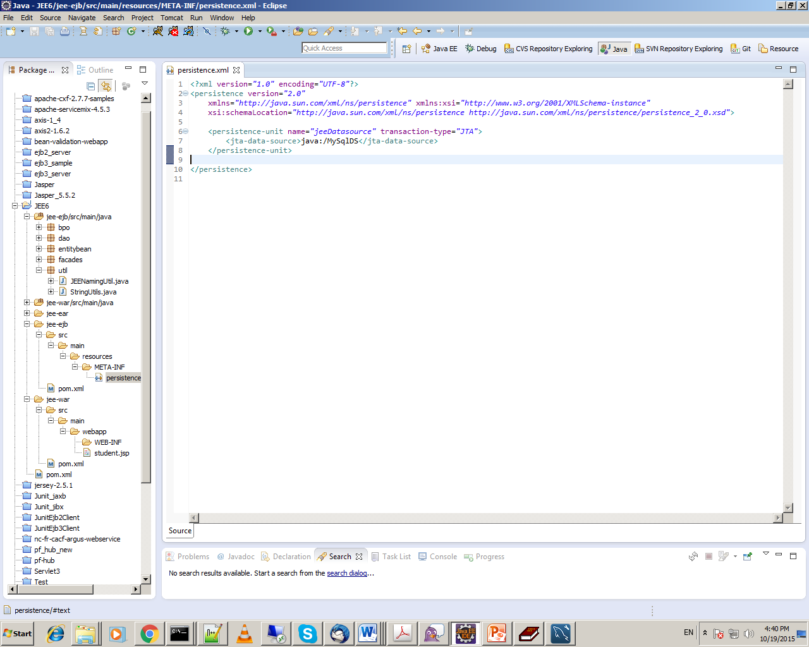
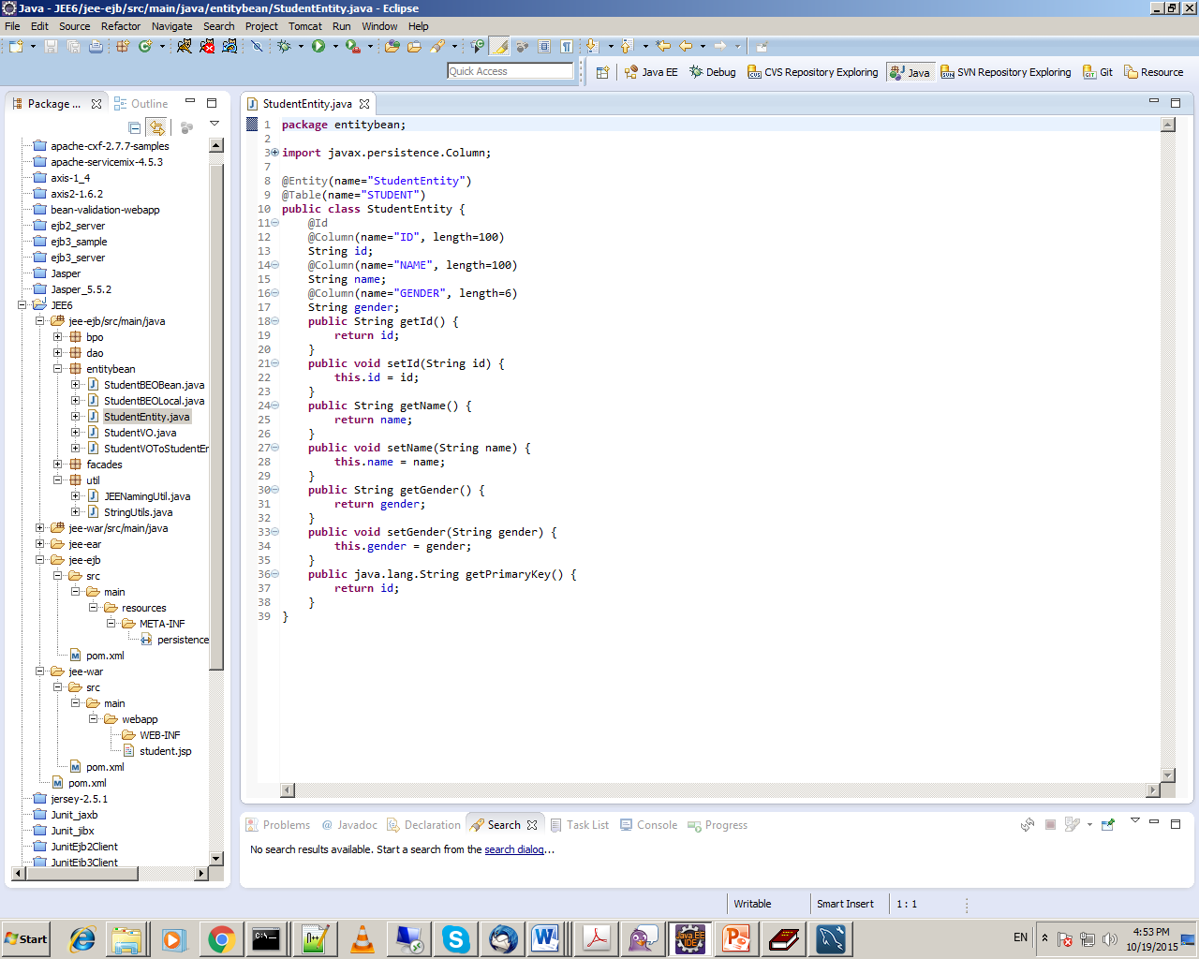
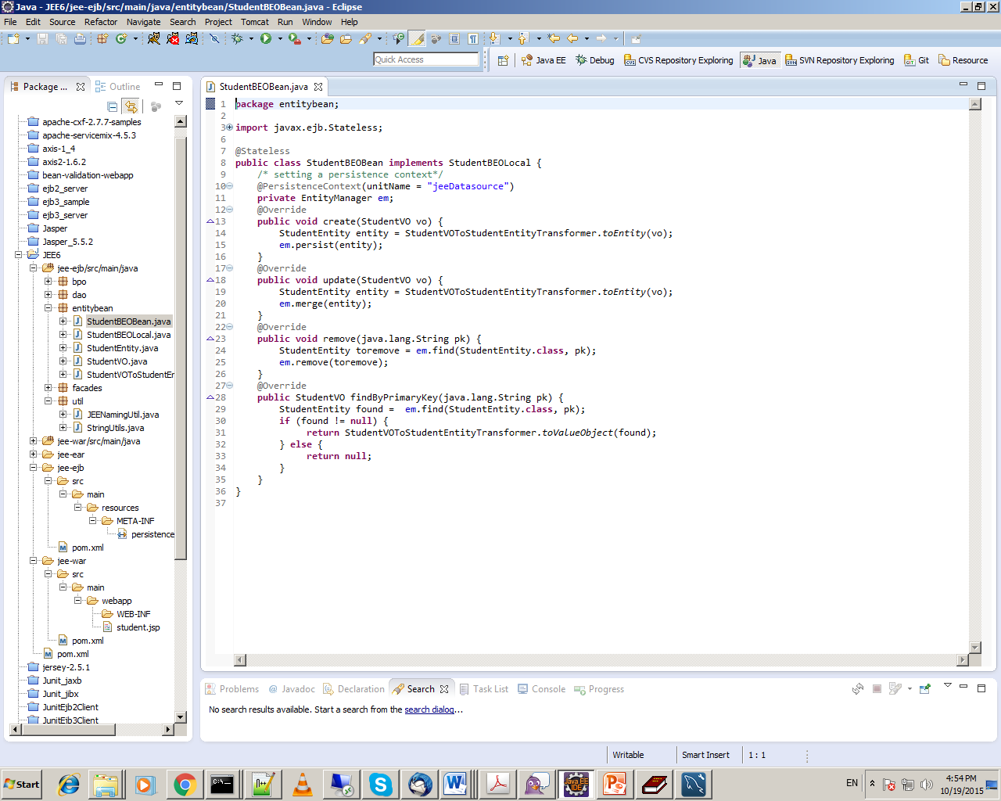
Coding
Accessing Database With Persistence

Slide 19
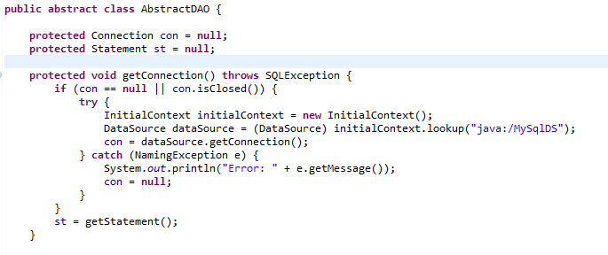
Accessing Database With JNDI Name Lookup
standalone.xml

Slide 20
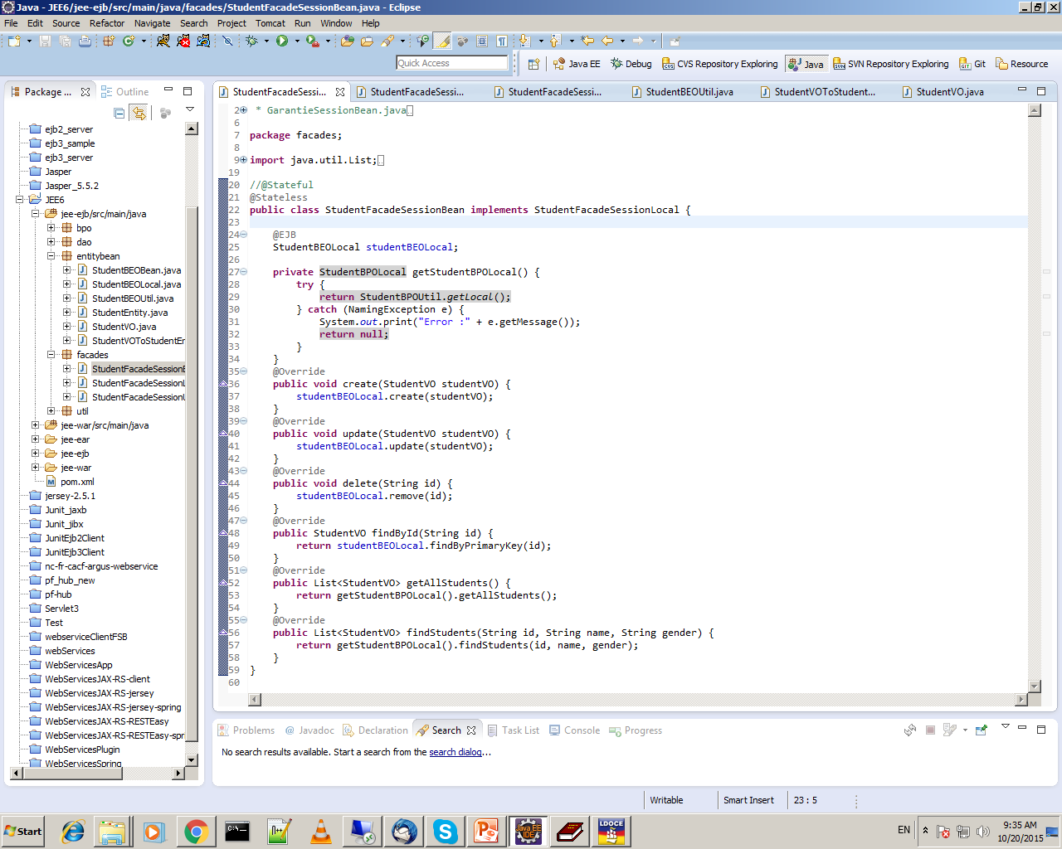
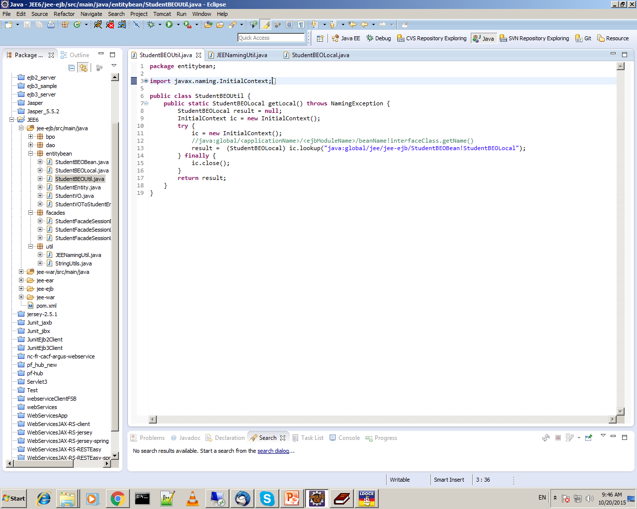
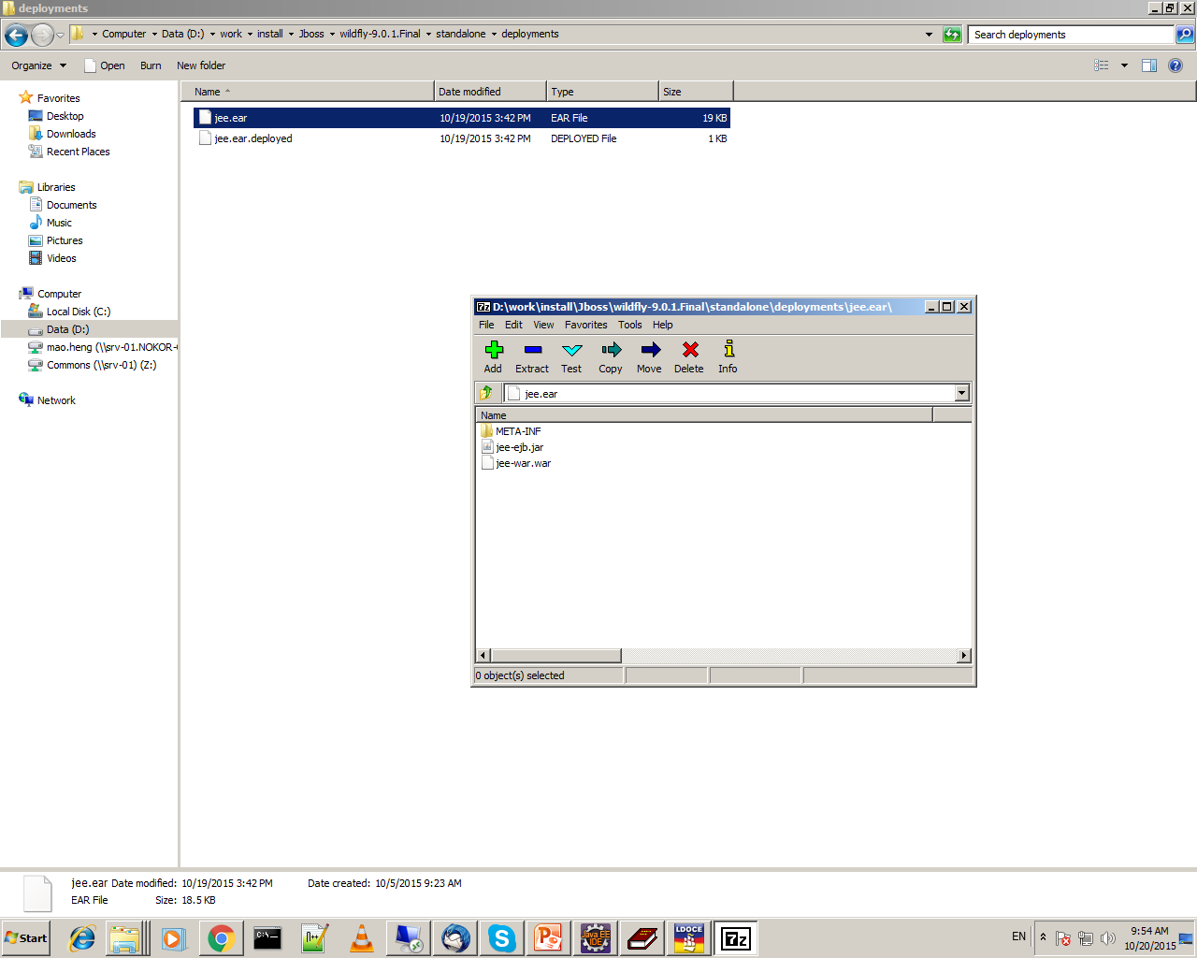
Accessing Enterprise Bean

Slide 21
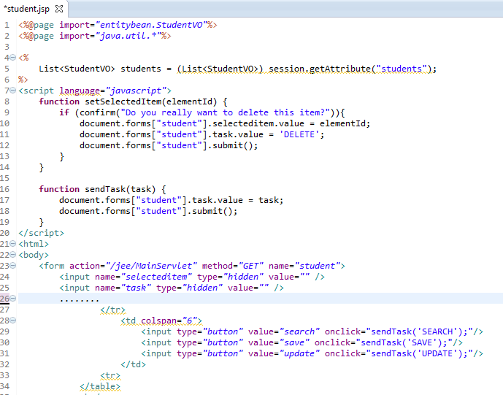
student.jsp

Slide 22
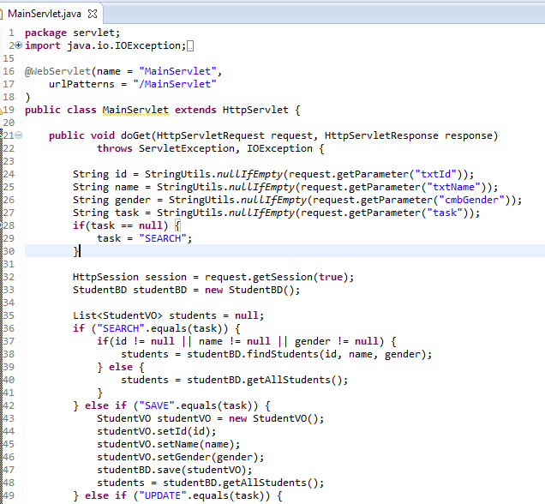
MainServlet.java

Slide 23
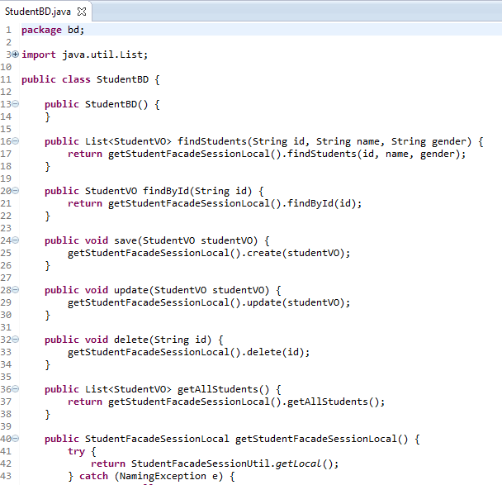
StudentBD.java

Slide 24
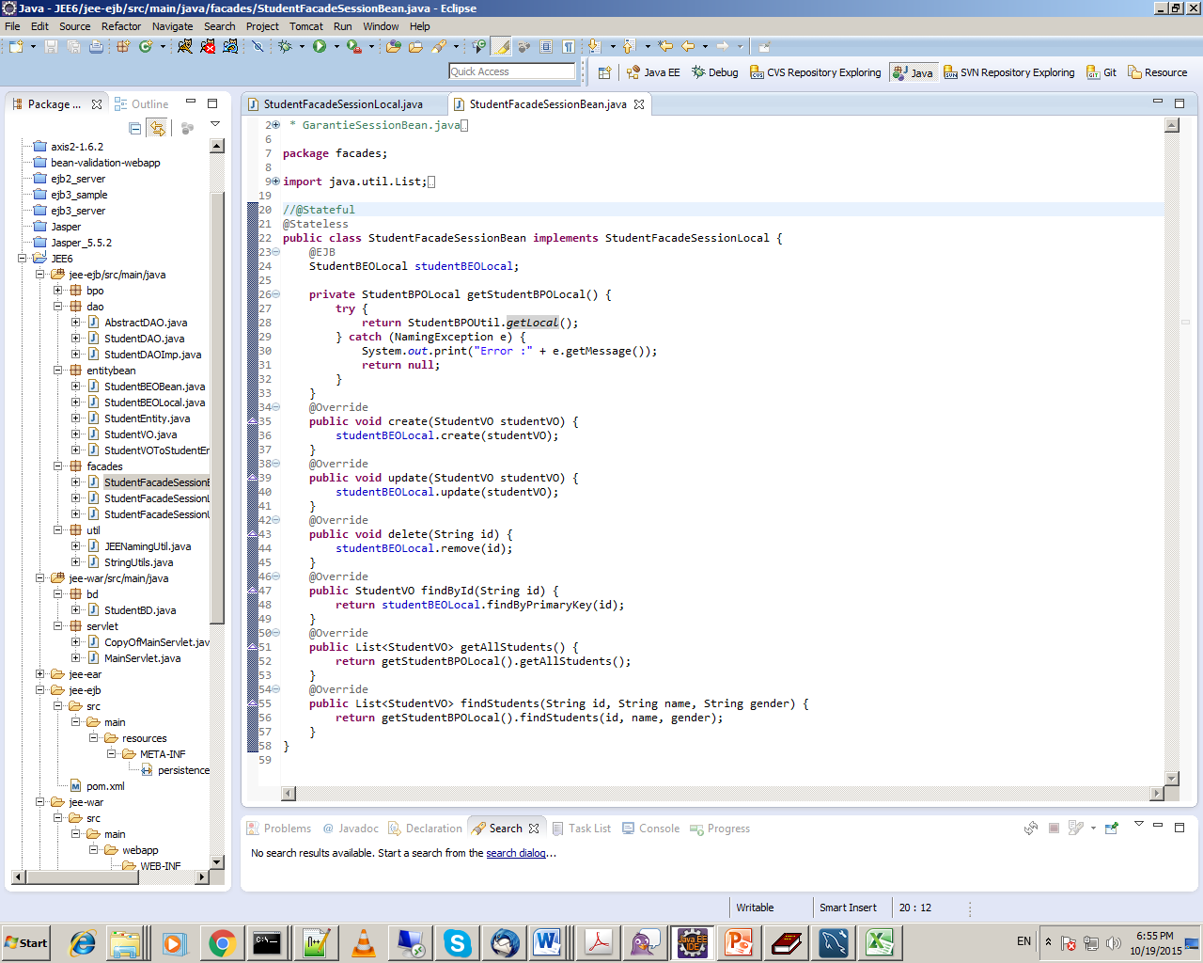
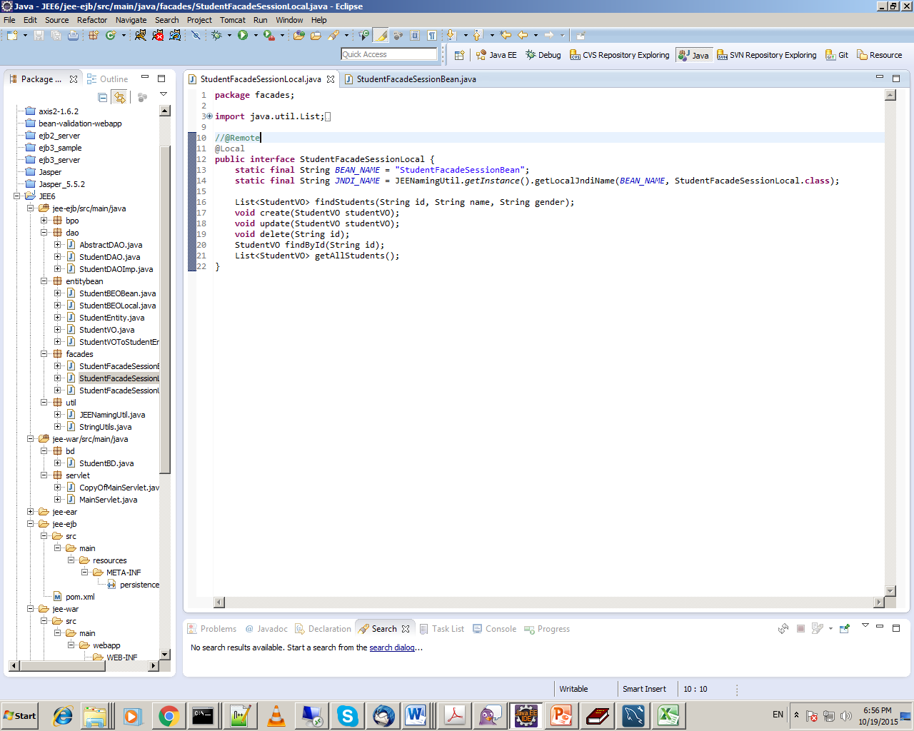
StudentFacadeSessionBean.java

Slide 25
StudentBEOBean.java

Slide 26
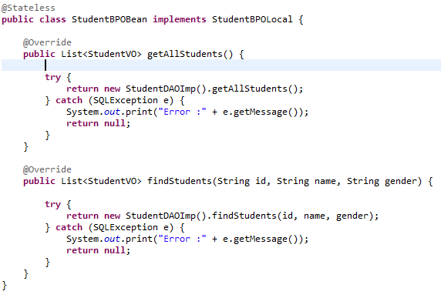
StudentBPOBean.java

Slide 27
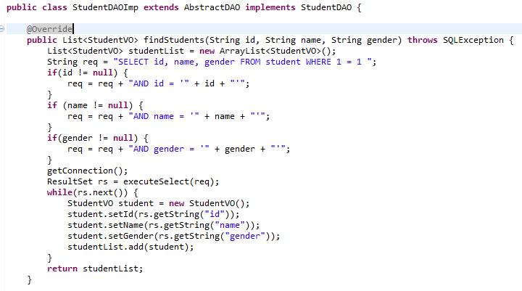
StudentDAOImp.java

Slide 28
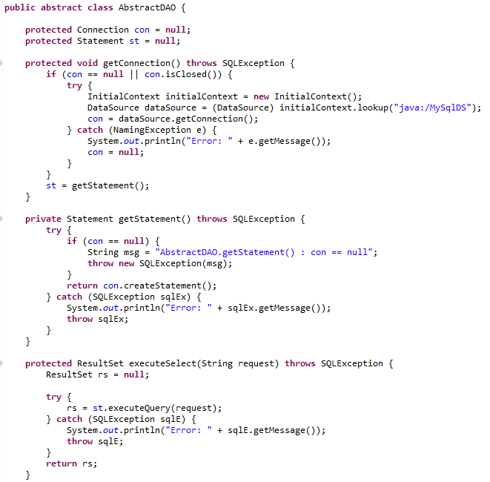

Slide 29
DEMO?

Slide 30
Any Questions?
Thanks You
Source Code: https://github.com/JavaCambodia/JavaEE-Sample

